Slide 1

Wolfram Syndrome
BIO 2116: Pathophysiology
Dr. Wilcox
Project members:
Charlotte Babcock, Jennifer Cronin, Garrett Dullin-Gonzalez, Brenda Perez Cruz, Shannon Wondrow
https://www.diabetes.co.uk/wolfram-syndrome.html
Notes:
For image: https://www.diabetes.co.uk/wolfram-syndrome.html

Slide 2



What is Wolfram Syndrome?
Wolfram Syndrome, also referred to as DIDMOAD, is a genetic mutation that results in a missing or mutated gene in the body
The primary Wolfram Syndrome 1 (WFS1) affects gene producing wolframin; a glycoprotein
DIDMOAD is an acronym related to the common symptoms of the disorder
Diabetes Insipidus (DI), Diabetes Mellitus (DM),
Optic Atrophy (OA) and Deafness (D)
The WFS1 gene mutation causes dysfunctional protein folding, Calcium homeostasis abnormalities, Endoplasmic Reticulum (ER) stress and Mitochondria dysfunction

Slide 3
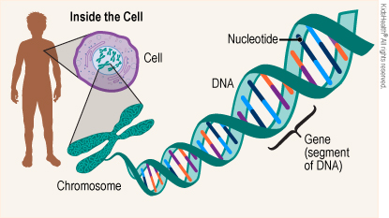
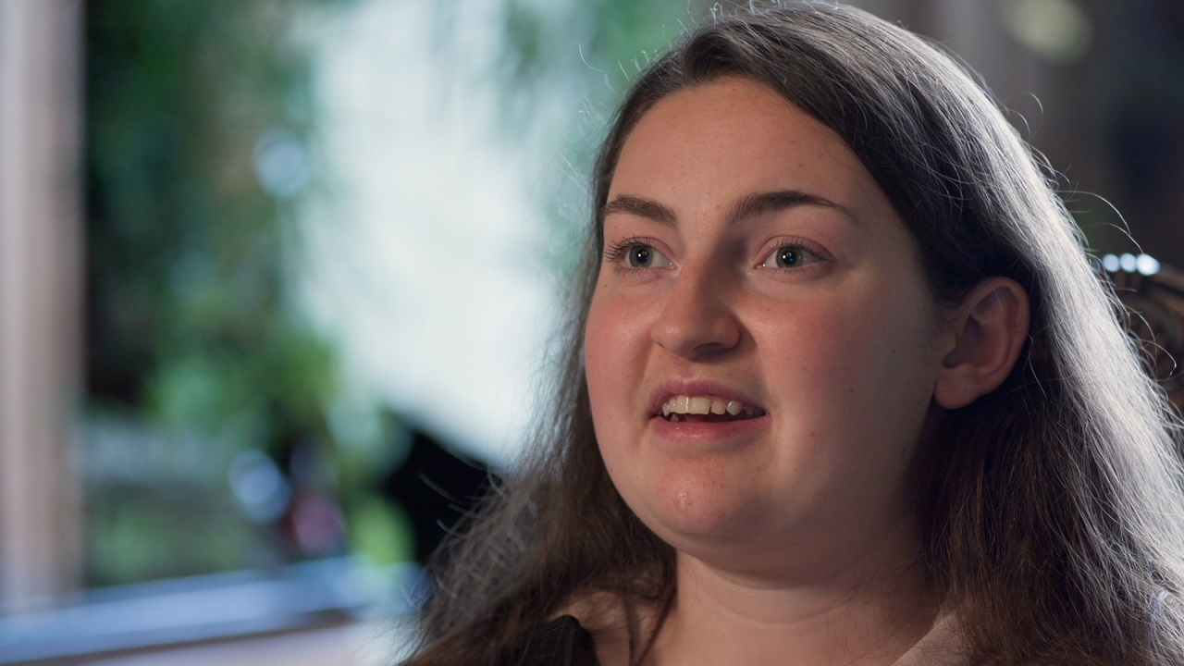
What is Wolfram Syndrome cont’d
This is a rare autosomal-recessive genetic disorder
  It affects about 1 in 160,000-770,000 people worldwide
It was discovered in 1938 by Wolfram and Wagener
  Studied siblings suffering from DM and OA
Ellie White:(bottom photo) a Colorado resident that is living with Wolfram syndrome… more to come on her story
https://kidshealth.org/en/teens/genes-genetic-disorders.html
https://www.rmpbs.org/blogs/rocky-mountain-pbs/ellie-white-wolfram-syndrome/
Notes:
For image: https://kidshealth.org/en/teens/genes-genetic-disorders.html
second image: https://www.rmpbs.org/blogs/rocky-mountain-pbs/ellie-white-wolfram-syndrome/

Slide 4
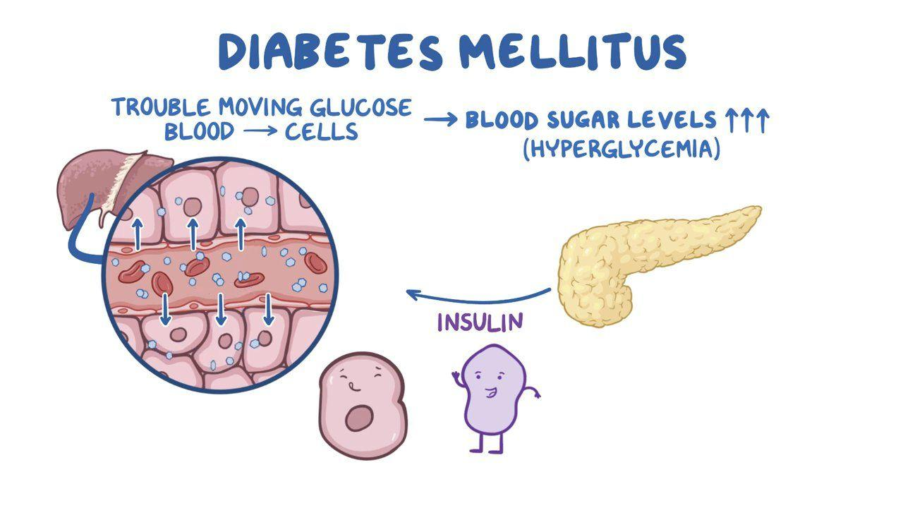
Signs and Symptoms
Many common symptoms tend to present from childhood to adolescence
Age 6: (diabetes mellitus) DM
  WFS1 decreases β-cells, lowers insulin causing diabetes
  Occurs in about 87% of patients
  Cannot absorb glucose from diet, treated with insulin therapy
  DM clinically diagnosed earlier with WFS1 than type 1 DM (T1DM)
  Not autoimmune, no antibodies present against β-cells
  Symptoms: frequent urination, increased thirst, blurry vision, weight loss
https://www.osmosis.org/learn/Endocrine_system:_Diabetes_mellitus
Notes:
For image: https://www.osmosis.org/learn/Endocrine_system:_Diabetes_mellitus

Slide 5
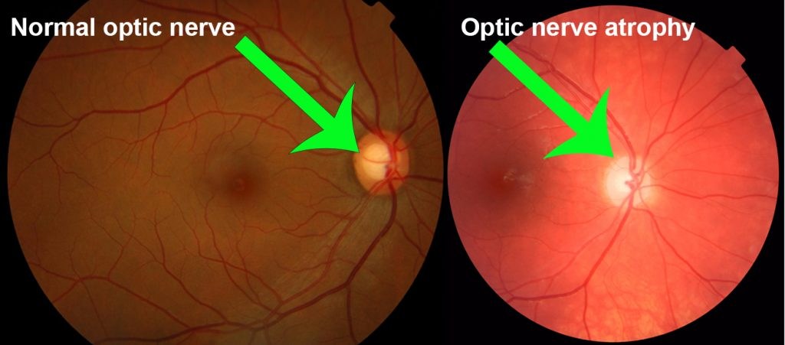
Signs and Symptoms cont’d
Age 11: Optic Atrophy (OA)
  WFS1 mutation causes atrophy in optic nerve
  Leads to progressive loss of vision
  Occurs in about 80% of patients
  Symptoms
    Blurry vision
    Loss of color vision
    Reduced peripheral vision
https://gene.vision/knowledge-base/dominant-optic-atrophy-for-patients/
Notes:
For image: https://gene.vision/knowledge-base/dominant-optic-atrophy-for-patients/

Slide 6
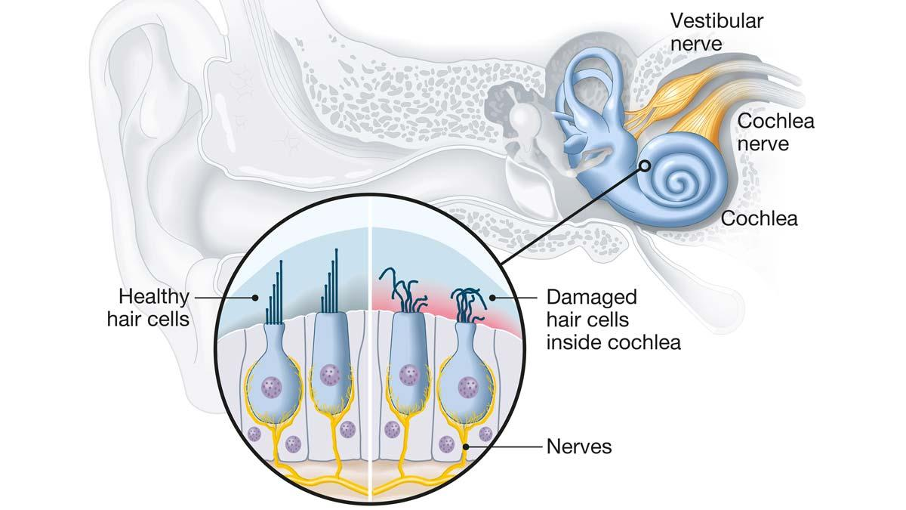
Signs and Symptoms cont’d
Age 13: Sensorineural hearing loss (Deafness)
  Genetic mutation of WFS1 causes constant damage to hair cells and auditory nerve.
  Common in around 65% of patients
  Symptoms
    Initially have loss of high-frequency sounds
    Eventually progress to low-frequency sounds
    Due to neuronal damage, will usually result in eventual complete deafness
    Progresses much quicker than most sensorineural hearing loss
https://www.hearingtracker.com/hearing-loss/sensorineural-hearing-loss
Notes:
For image: https://www.hearingtracker.com/hearing-loss/sensorineural-hearing-loss

Slide 7
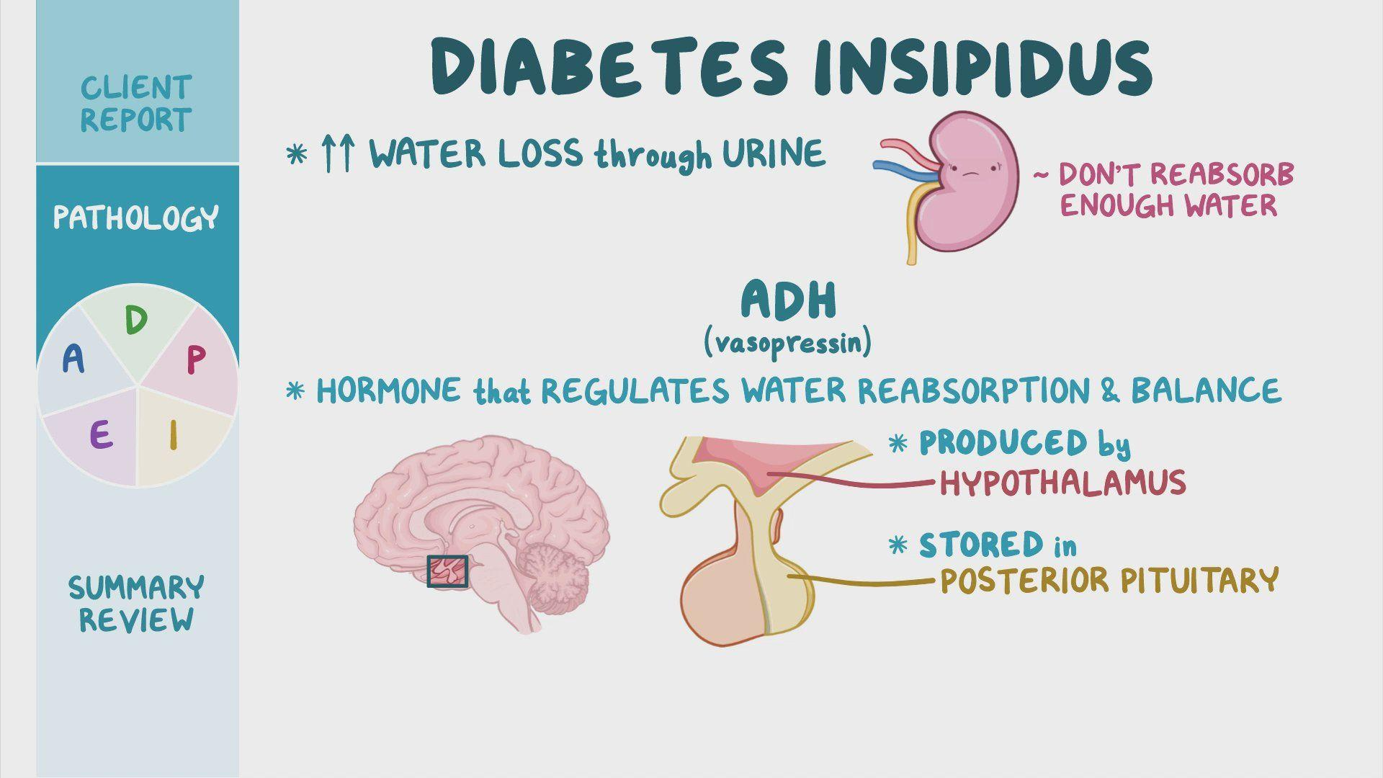
Signs and Symptoms cont’d
Age 14: Diabetes Insipidus *central* (DI)
  Common in around 70% of patients
  Causes an issue with neural tissue in posterior pituitary responsible for ADH secretion
  Symptoms
    Large amounts of dilute urine
    Polydipsia
    Nocturia
    dehydration
https://www.osmosis.org/learn/Diabetes_insipidus:_Nursing_Process_%28ADPIE%29
Notes:
For image: https://www.osmosis.org/learn/Diabetes_insipidus:_Nursing_Process_%28ADPIE%29

Slide 8
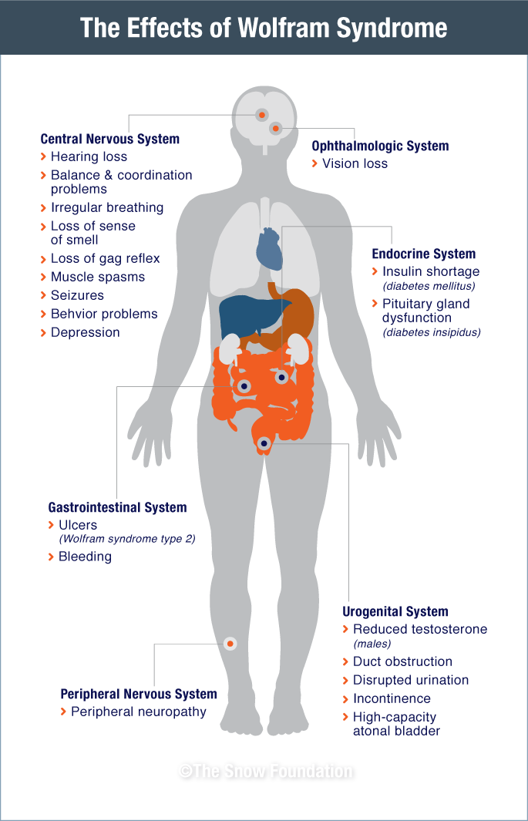
Other common signs and symptoms
Urinary problems
  Obstruction of ureters
  Bladder sphincter dyssynergia
  More risk of bladder infections
Neurological Disorder
  Ataxia (balance and coordination issues)
  Hearing loss
  Brain stem atrophy
  Chronic Fatigue
  Decline of physical stamina
  Increase of sleep
https://thesnowfoundation.org/wolfram-syndrome/

Slide 9
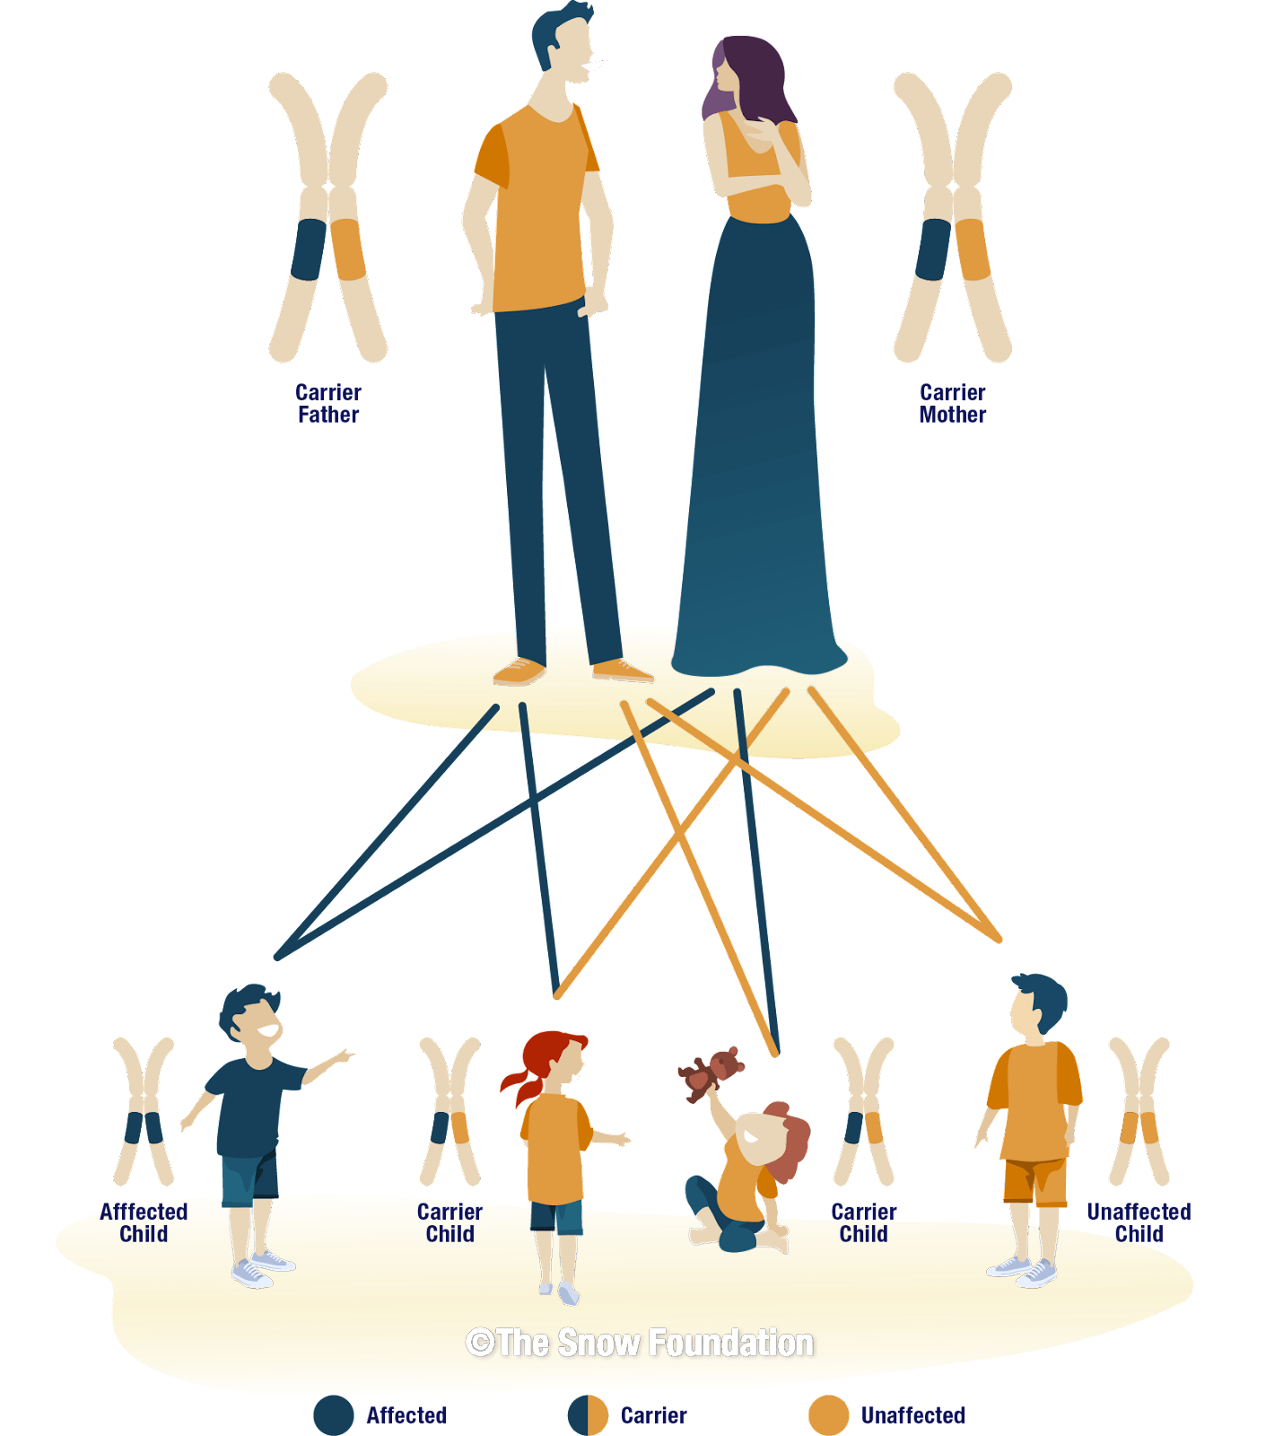
Contributing Factors
Wolfram Syndrome is a genetic disorder that can only be transmitted to a child by two parents that both are carriers of the WFS1 gene.
  This disease is classified as an autosomal recessive disorder
  This means that there is a 25% chance of a child getting the disease that is born of two carrier parents.
https://thesnowfoundation.org/wolfram-syndrome/
Notes:
for image: https://thesnowfoundation.org/wolfram-syndrome/

Slide 10
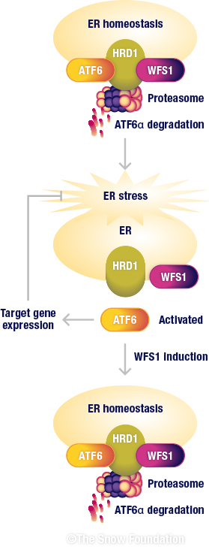
Pathophysiology of Wolfram Syndrome
Normally, WFS1 gene helps to regulate the homeostasis of the Endoplasmic Reticulum (ER) as well as Calcium balance in the cells and in the Mitochondria
mRNA information delivered to ER where WFS1 aids in the folding of final protein product
If there is an issue with the protein folding cells initiate Unfolded Protein Response (UPR)
this cascade uses other regulating proteins like Activating Transcription Factor 6 (ATF6) which strengthens cells effort to properly fold proteins
Another regulator, HMG-CoA reductase degradation protein 1 (Hrd1) which helps to breakdown any misfolded ER proteins in the cell.
This process allows cell to remain in homeostasis
**normal cell process pictured right**
https://thesnowfoundation.org/wolfram-syndrome/

Slide 11
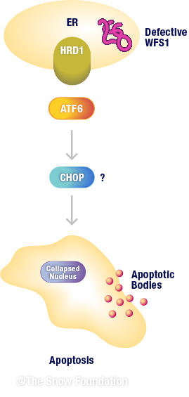
Pathophysiology of Wolfram Syndrome Cont’d
In a patient with Wolfram syndrome, the WFS1 is defective
mRNA brought to the ER has a harder time producing properly folded proteins
the UPR is initiated to try and maintain homeostasis
ER homeostasis is not achieved and UPR is continually activated
cell produces regulators that initiate cell apoptosis, like C/EMB homologous protein (CHOP)
  when enough of this regulator is present, the cell initiates cell apoptosis
This process is proliferated over and over again in cells in the body leading to presentation and progression of symptoms
https://thesnowfoundation.org/wolfram-syndrome/

Slide 12
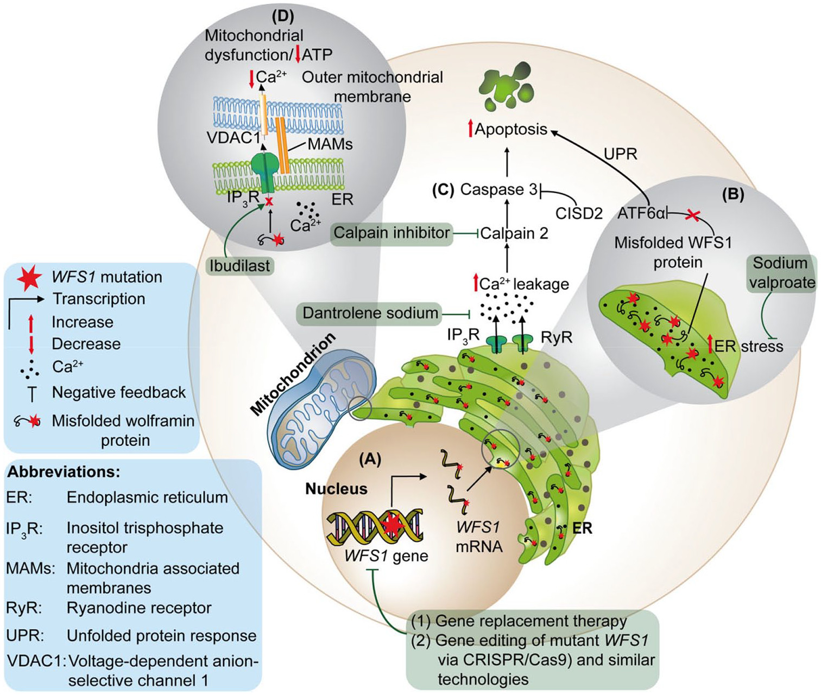
Pathophysiology Cont’d
Mutation of WSF1 gene located within DNA
Deficiency of Ca^2+ in mitochondria causes phagocytosis, mitophagy
Lowered mitochondria function→ lower production of ATP
Dysregulated ER Ca2+ signaling
Ca²⁺ leakage → apoptosis
ER stress → misfolded WFS1 protein
Misfolded WFS1 protein → apoptosis
Apoptosis →neurodegeneration
https://doi.org/10.1177/26330040211039518
Notes:
Mishra, R., Chen, B. S., Richa, P., & Yu-Wai-Man, P. (2021). Wolfram syndrome: New pathophysiological insights and therapeutic strategies. Therapeutic Advances in Rare Disease. https://doi.org/10.1177/26330040211039518

Slide 13
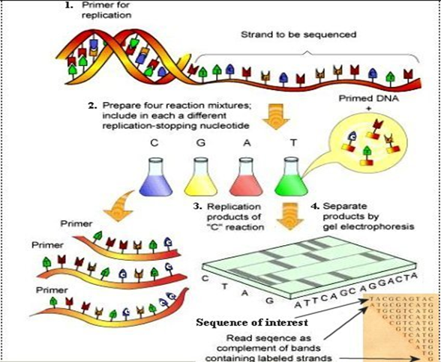
Diagnosis
The more symptoms that develop, the more likely to test for the disorder
DM and OA before the age of 16 are most common signs
genetic testing usually involves testing parental DNA as well as patient DNA
Confirmation of diagnosis through the sanger sequencing method (pictured right)
  tests for the specific gene mutation found in Wolfram Syndrome (WFS1)
https://biotecharticles.com/Genetics-Article/Sanger-Sequencing-Chain-termination-method-of-DNA-Sequencing-3937.html
Notes:
Image: https://biotecharticles.com/Genetics-Article/Sanger-Sequencing-Chain-termination-method-of-DNA-Sequencing-3937.html

Slide 14
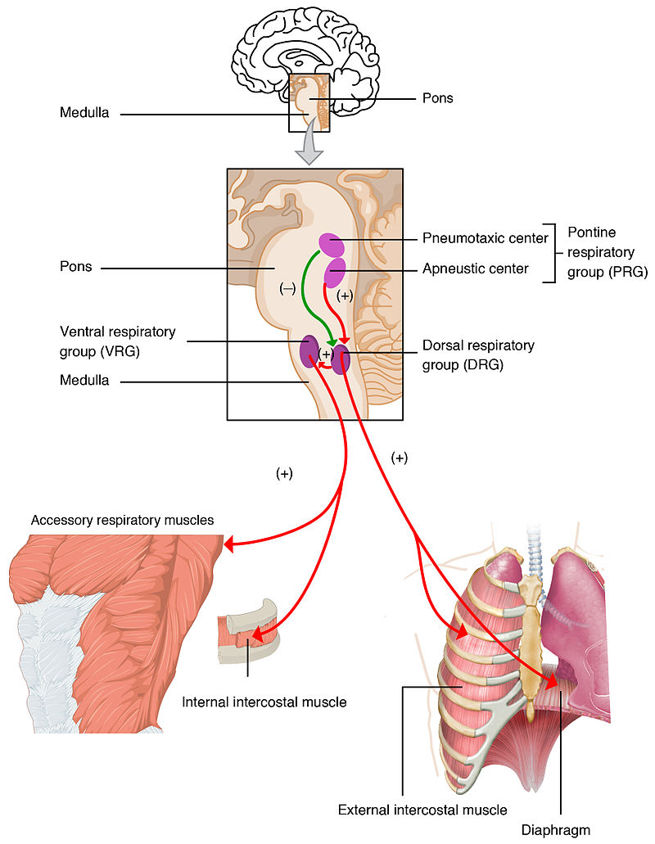
Diagnosis cont’d
Earlier diagnosis of the disease can allow for more treatment of the progression of the symptoms and potentially increase life-span
Because of the rarity of disease, it is unlikely to be tested for and diagnosed early
Prognosis is poor, with an average lifespan of 30 years old, ranging from 25-49
  brain stem atrophy over time interferes with respiratory centers and leads to patient’s inability to breath on their own
https://en.wikipedia.org/wiki/Respiratory_center

Slide 15
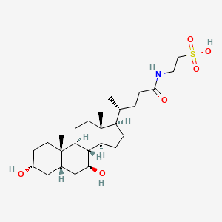
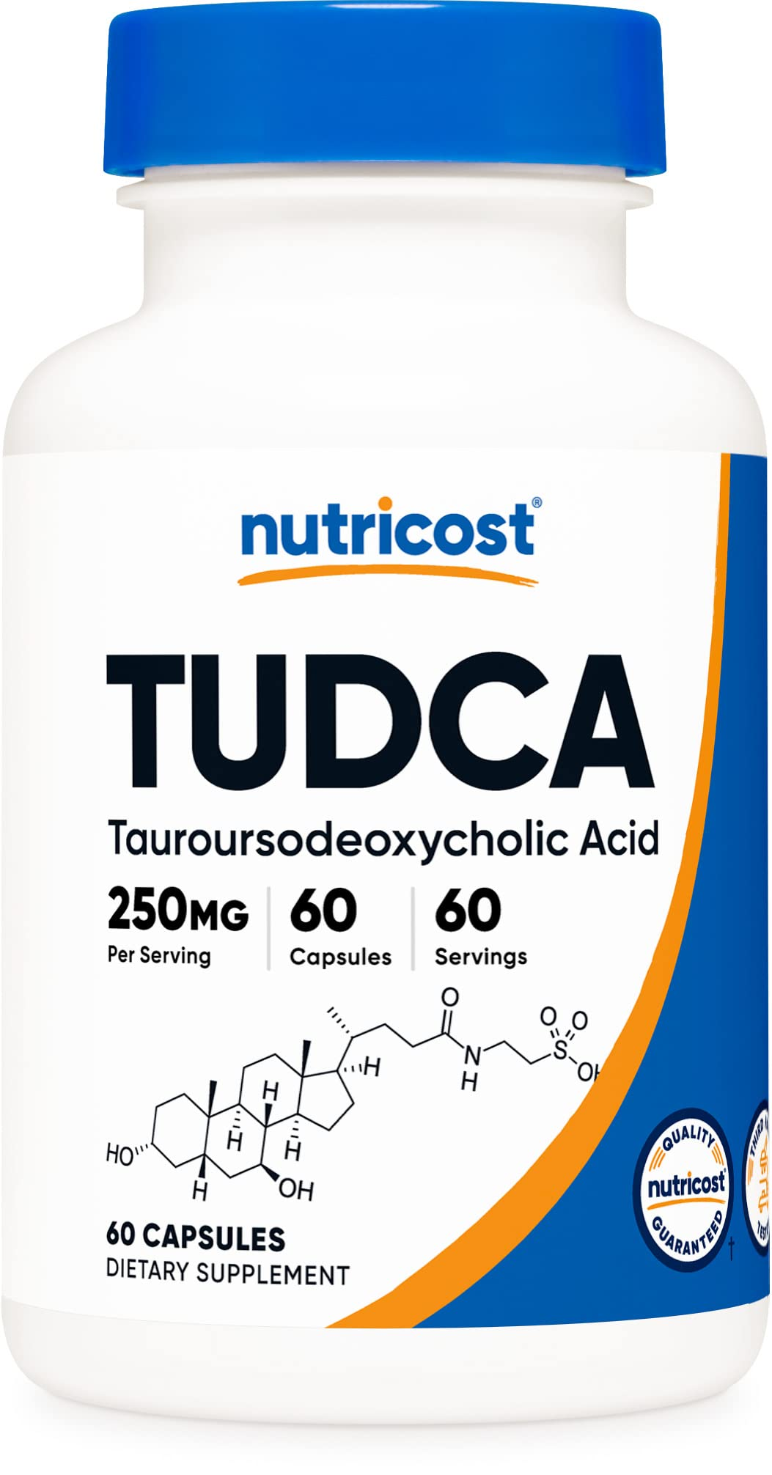
Treating Wolfram Syndrome
Currently no treatments, medications that are proven to treat this genetic disease specifically
methods of treatment almost entirely include managing symptoms
One medication being studied is use of tauroursodeoxycholic acid (TUDCA)
  a chemical chaperone: promotes proper folding of a protein
  mitigates the ER stress that WFS1 causes
  could greatly slow down the progression of cellular apoptosis
  if effective, earlier diagnosis and use of TUDCA could prolong patient lives, keep progression at bay
https://pubchem.ncbi.nlm.nih.gov/compound/Tauroursodeoxycholic-acid
https://www.amazon.com/Nutricost-Tudca-250mg-Capsules-Tauroursodeoxycholic/dp/B01A68H2BA

Slide 16

Caring for Wolfram Syndrome Patients
Managing symptoms, monitoring progression, addressing changes are currently the best ways to care for patients
having an effective care team to aid in monitoring, researching, planning, therapy, and day to day care
Many symptoms need to be treated, but the most common, DI, DM, OA, and D need to be addressed to keep up quality of life, and ensure a healthy patient for as lost as possible
https://www.sralab.org/sites/default/files/inline-images/Care%20Team%20Graphic_Circle%20%281%29.png

Slide 17
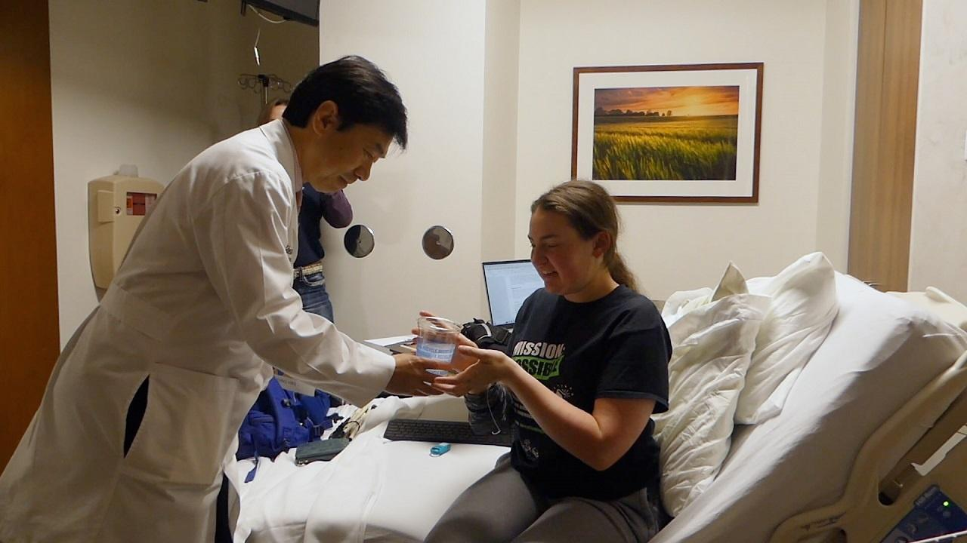
Caring for Wolfram Syndrome Patients cont’d
DM management
  keep blood glucose levels monitored, and under control.
  checking before and after meals, or with a continuous monitor
DI management
  medication administration to replace impaired pituitary secretion of ADH
  use of a vasopressin hormone, dDvap to act in place of ADH
OA management
  not many treatments for this symptom
  annual eye exams to check progression and treat eyesight as best as possible
D management
  hearing aids and cochlear implants can do wonders with treating the sensorineural hearing loss
https://www.rmpbs.org/blogs/rocky-mountain-pbs/ellie-white-wolfram-syndrome/

Slide 18
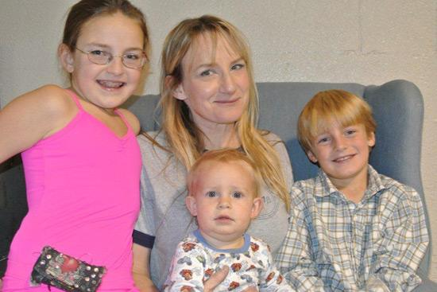

Dancing Through It All: Ellie’s Dx
Age 3 : Diabetes Mellitus
  Excessively thirsty, sticky/viscous urine noticed by mother
  Had initial blood glucose levels over 400 mg/dL normal being below 120 mg/dL
Age 7: Optic Atrophy
  At age 6 was unable to have vision corrected to 20/20 by ophthalmologist
  At age 7 discovered Ellie had developed colorblindness
    1:200 girls are colorblind at birth, it is MUCH rarer to develop colorblindness
Age 8: Wolfram Syndrome
  Shortly after confirmation of OA, a neuro-ophthalmologist did genetic testing and confirmed the rare diagnosis
  Elli performs on America’s Got Talent with The Silhouettes

Slide 19



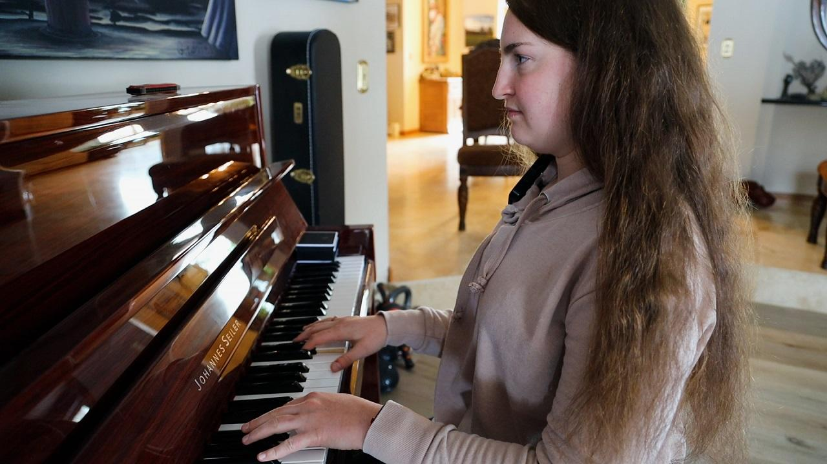
Dancing Through It All: Ellie’s Dx
Age 10: Ellies Foundation
  Elli and Mother, Beth, start non-profit to raise money for Juvenile diabetes, and WFS1
Ellie and her mother have raised tens of thousands of dollars with their non-profit
Ellie’s mother, a molecular biologist, drives research herself for WFS1 treatments
  Brought attention to the potential benefits of the drug TUDCA
  Initially fought for medical professionals to look into her daughter’s symptoms earlier and was able to get diagnosed very early for such a rare disease
Colorado Voices Video: Ellie White
26 minute video, all about Ellie and her story. Completely optional but a very inspiring video

Slide 20


Dancing Through It All: Ellie’s Dx
Age 18: Attends Center for Blind
  Travels to St. Louis often to see Dr. Urano who helps with her treatment and research of WFS1
  Attended Colorado Center for Blind once vision got low enough
    Walks with a cane, read/write in braille
Age 22: Thriving with Wolfram Syndrome
  Climbs 14ers, skydives, plays piano
    As Ellie says, “I have Wolfram syndrome, but Wolfram syndrome doesn’t have me”
  She also has done fencing, dances, white water rafting
  Currently, her most notable symptoms are only DM and OA, she does not have any issues with her hearing or the other classic symptom of DI
Gabriel Lehman (artist): Dancing Through it All
Shows Ellie’s world as she now sees it; with orange skies, pink clouds, purple trees and grass. We also see Ellie, smiling, and seemingly, with no effort, dancing in the beautiful world she now sees through the eyes of Wolfram Syndrome
Notes:
https://www.gabriellehman.com/prints/dancing-through-it-all

Slide 21
References
Barrett, T. G., Bundey, S. E., & Macleod, A. F. (1995). Neurodegeneration and diabetes: UK nationwide study of Wolfram (DIDMOAD) syndrome. Lancet (London, England), 346(8988), 1458–1463. https://doi.org/10.1016/s0140-6736(95)92473-6
Cleveland Clinic (2022, August 17). Wolfram Syndrome. My Cleveland Clinic Health Library. Retrieved September 26, 2023, from https://my.clevelandclinic.org/health/diseases/24044-wolfram-syndrome
Ellie White Foundation For Rare Genetic Disorders (n.d.). Retrieved October 3, 2023, from https://www.elliewhitefoundation.org/gallery
Kumar S. (2009, February, 11) Wolfram syndrome: important implications for pediatricians and pediatric endocrinologists. Pediatr Diabetes. (1):28-37. doi: 10.1111/j.1399-5448.2009.00518.x. PMID: 20015125
Li, L., Venkataraman, L., Chen, S., & Fu, H. (2020). Function of WFS1 and WFS2 in the Central Nervous System: Implications for Wolfram Syndrome and Alzheimer's disease. Neuroscience and biobehavioral reviews, 118, 775–783. https://doi.org/10.1016/j.neubiorev.2020.09.011
Mishra, R., Chen, B. S., Richa, P., & Yu-Wai-Man, P. (2021). Wolfram syndrome: New pathophysiological insights and therapeutic strategies. Therapeutic Advances in Rare Disease. https://doi.org/10.1177/26330040211039518

Slide 22
References Cont’d
Rigoli, L., Caruso, V., Salzano, G., & Lombardo, F. (2022, March 9). Wolfram Syndrome 1: From Genetics to Therapy. NIH National Library of Medicine; National Center for Biotechnology Information. Retrieved September 22, 2023, from https://www.ncbi.nlm.nih.gov/pmc/articles/PMC8949990/
Samara, A., Rahn, R., Neyman, O. et al. (2019) Developmental hypomyelination in Wolfram syndrome: new insights from neuroimaging and gene expression analyses. Orphanet J Rare Dis 14, 279. https://doi.org/10.1186/s13023-019-1260-9
Urano F. (2016). Wolfram Syndrome: Diagnosis, Management, and Treatment. Current diabetes reports, 16(1), 6. https://doi.org/10.1007/s11892-015-0702-6

